Slide 1
gem5 Workshop 2023 Welcome Presentation
Presentation by Bobby R. Bruce

Slide 2


It’s great to see y’all here
The high-level agenda:
20 presentations.
A panel Session: “The Future of gem5”.
Poster session.
Awards.
House keeping:
Coffee Break: 11:00 – 11:20
Lunch: 12:30 – 14:00
Coffee Break: 15:30 – 16:00
Closing: 17:00
https://www.gem5.org/events/isca-2023
2

Slide 3
Most important thing: WiFi
Network: FCRC2023
Password: fcrc23ACM
3

Slide 4

Why are we here?
The leading open-source computer-system architecture simulator.
Officially released 2011 (though merger of m5, 2002, and GEMS, 2000).
Over 20,000 commits, over 450,000 lines of code.
Over 1,000 commits in the last year.
Distributed development: Industry, Academia, Research Labs, anyone,
4

Slide 5
Why are we here?
The purpose of the gem5 Workshop is to give members of the gem5 community to meet in person, share their work, and discuss and plan for the future of gem5.
5

Slide 6
What’s happened since we last met?
A small selection of noteworthy achievements.
6

Slide 7
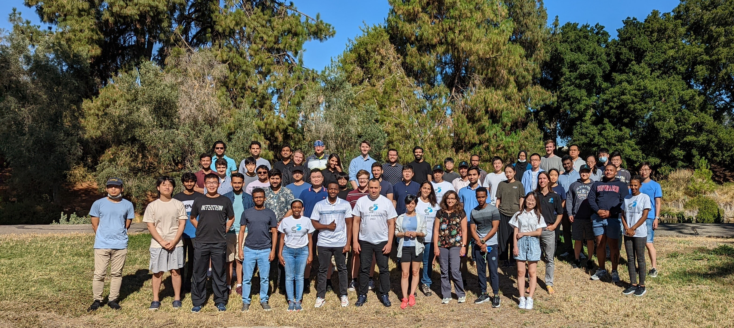
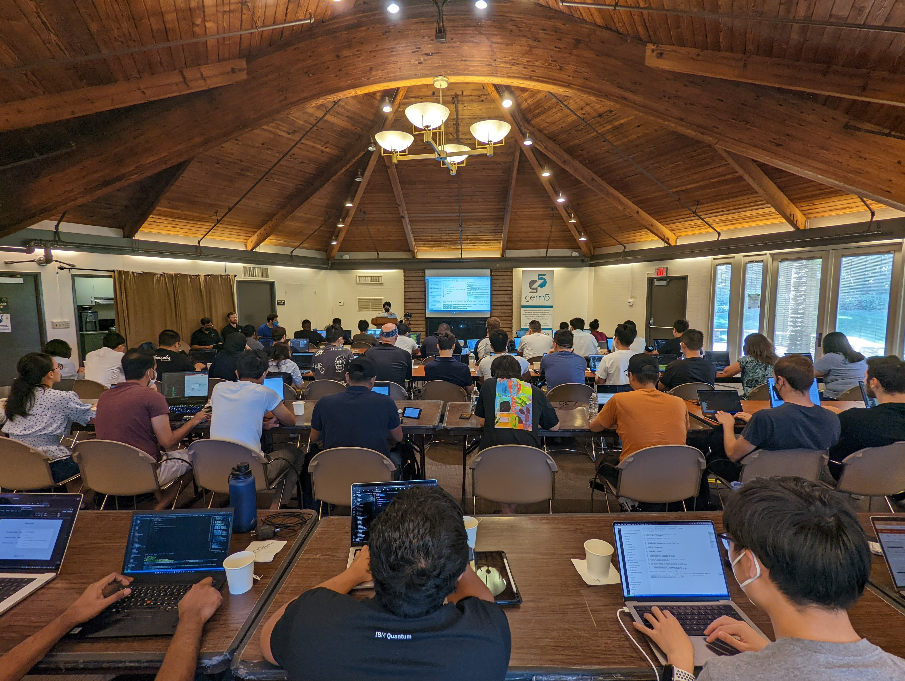
What’s happened since we last met? The 2022 Bootcamp
50 attendees.
5 Full days.
A comprehensive course on gem5.
Hosted at UC Davis, all expenses paid.
Feedback received:
95% ”strongly agreed” that the Bootcamp was valuable in getting started with gem5.
95% ”agreed” or “strongly agreed” that the Bootcamp helped them accomplish their research goals.
81% were “more confident” or “much more confident” in modifying gem5.
7

Slide 8
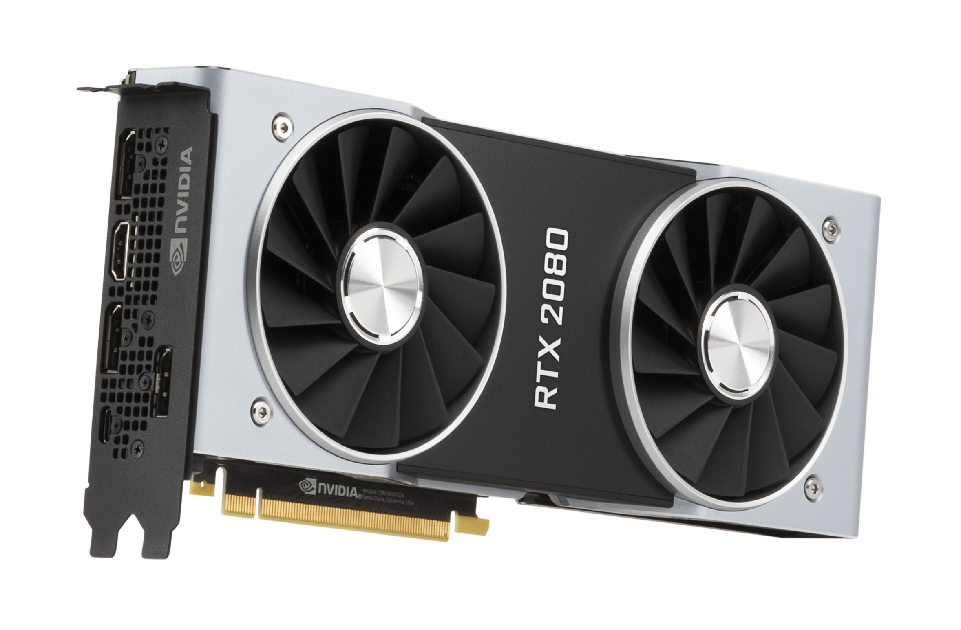
What’s happened since we last met? GPU-FS
Simulation
Guest OS
gem5
Host
8

Slide 9
What’s happened since we last met? Simpoint/Looppoint
0
4B
9

Slide 10
What’s happened since we last met? Simpoint/Looppoint
0
1B
2B
3B
Zhantong to talk about this at 9:40
10

Slide 11
What’s happened since we last met? All/gem5
MIPS
ARM
POWER
ALL
SPARC
X86
RISCV
pre-Version 22.1
Version 22.1+
11

Slide 12
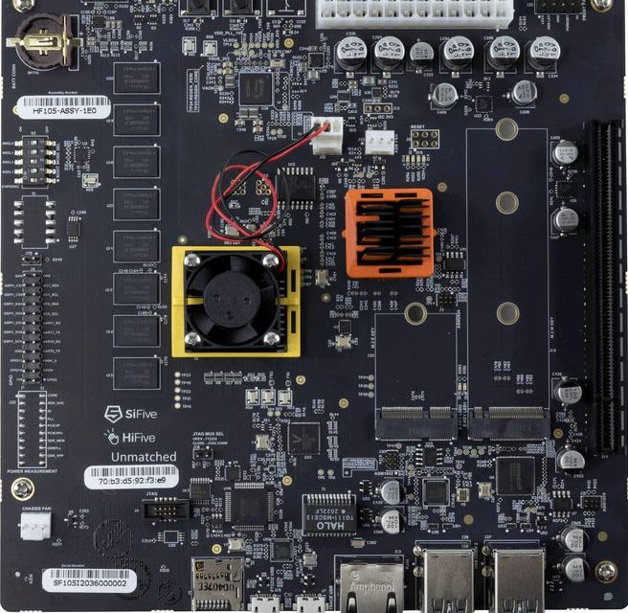


What’s happened since we last met? Started “Known Good Configs”
SiFive Unmatched Board
RISCV Matched Board
12

Slide 13
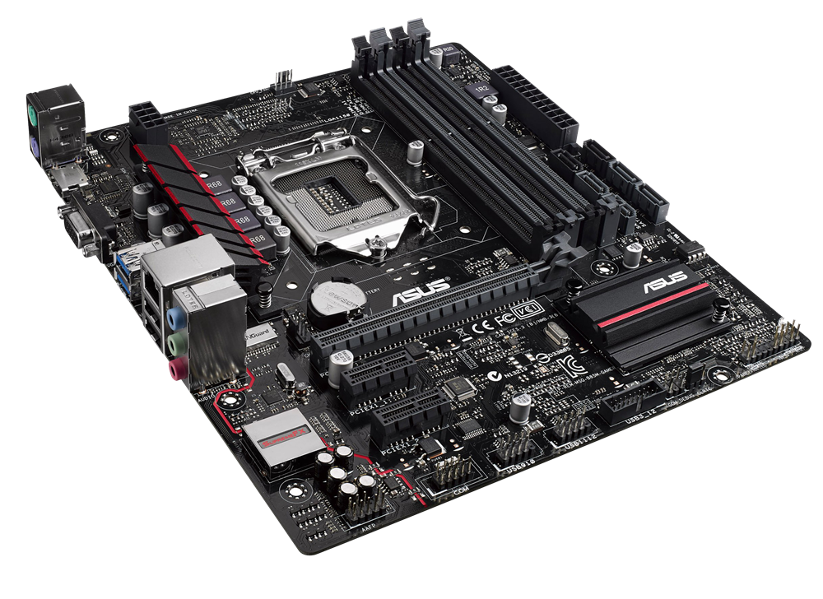
What’s happened since we last met? Simulator Module
Simulation Loop
Simulator
Exit Events
Load
The Simulator module loads a simulation and can be configured by the user to handle Simulation loop Exits to perform useful functionality. E.g., create a Checkpoint.
Checkpoints
13

Slide 14
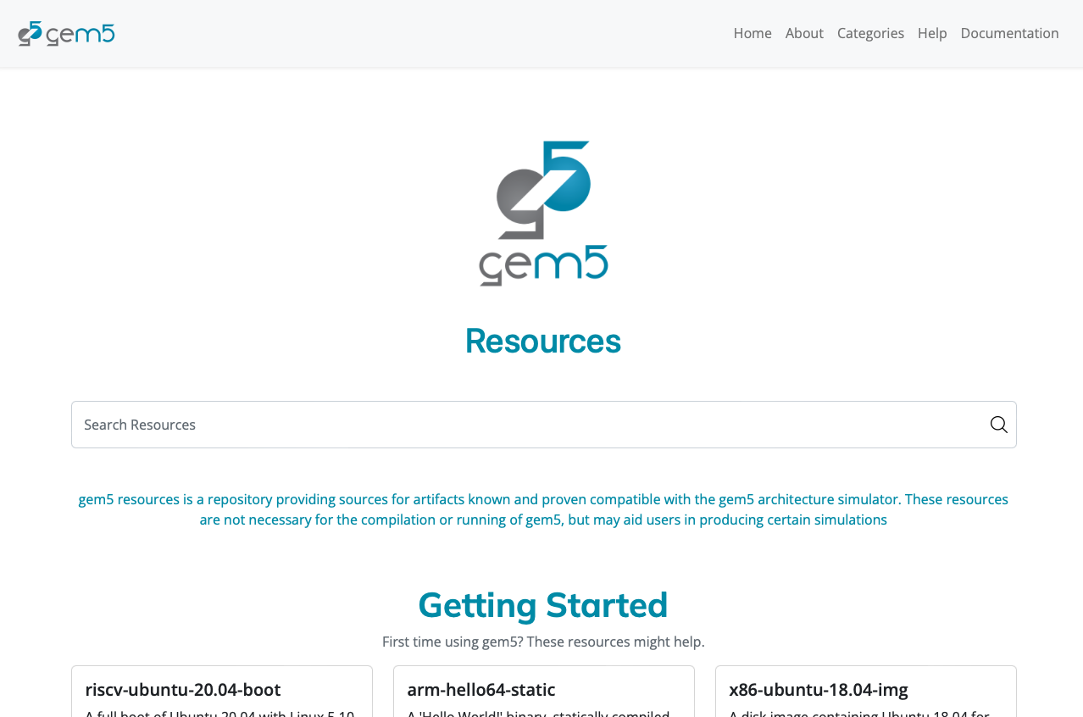
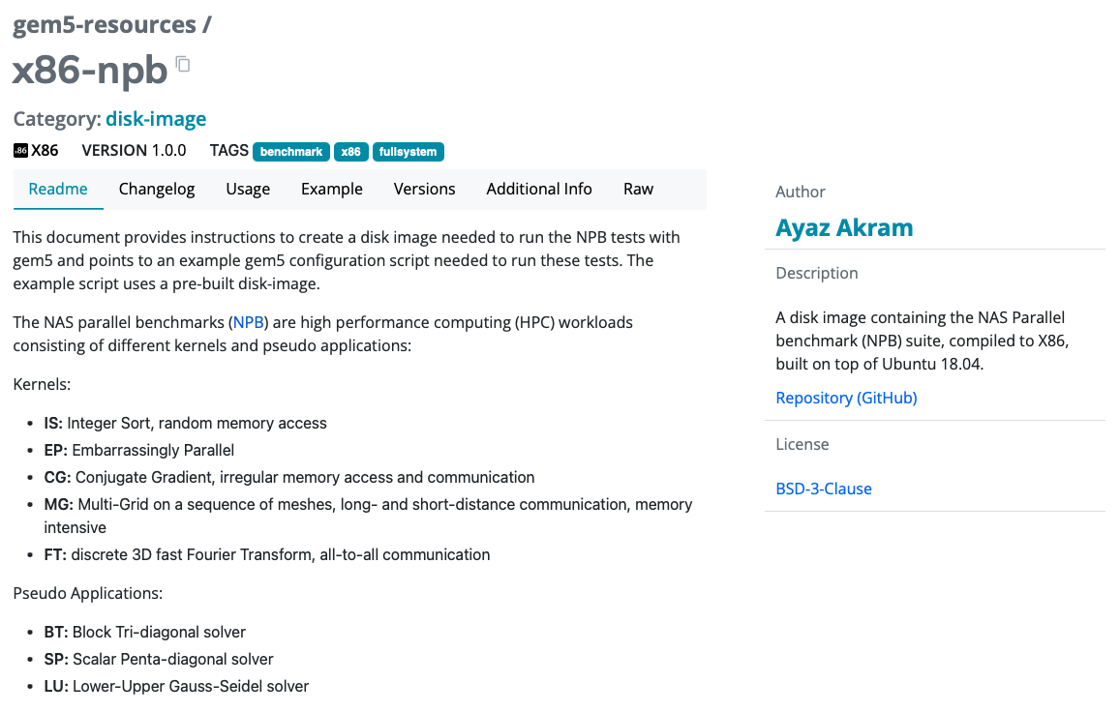
What’s happened since we last met? gem5 Resources Improvements
Resources data now stored primarily in a Mongo Database.
https://resources.gem5.org
14

Slide 15
What are we working on?
A sneak peek of features to come.
15

Slide 16
What are we working on? Multiprocessing
gem5 orchestration framework
gem5 Config
16

Slide 17

What are we working on? gem5Art Revival
Automatically log the state of a simulation.
Enables reproduction of a simulation.
Completely recreate a simulation run via a standardized definitions of a simulation.
Better manage simulation outputs (a cleverer “m5out”).
17

Slide 18
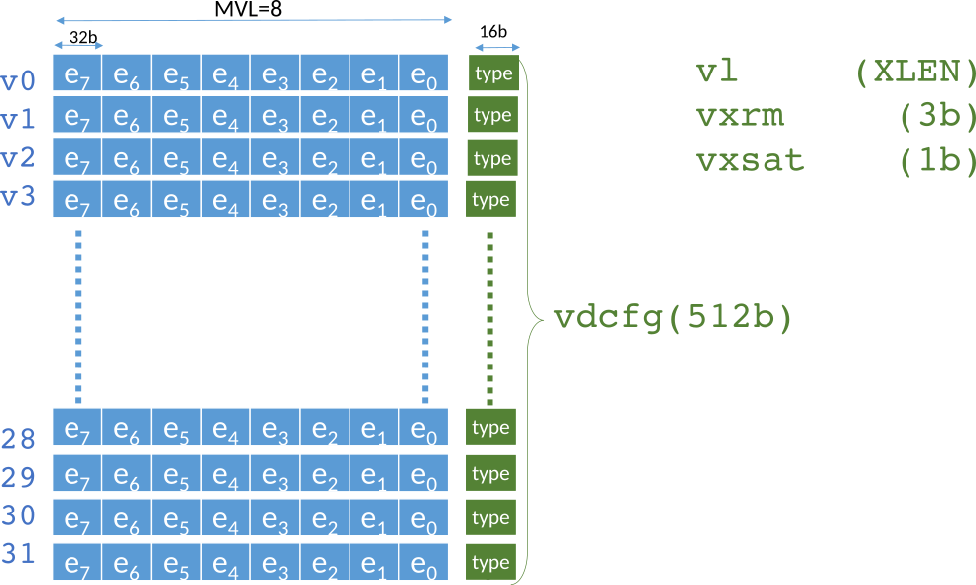
What are we working on? RISC-V Vector Extensions
18

Slide 19
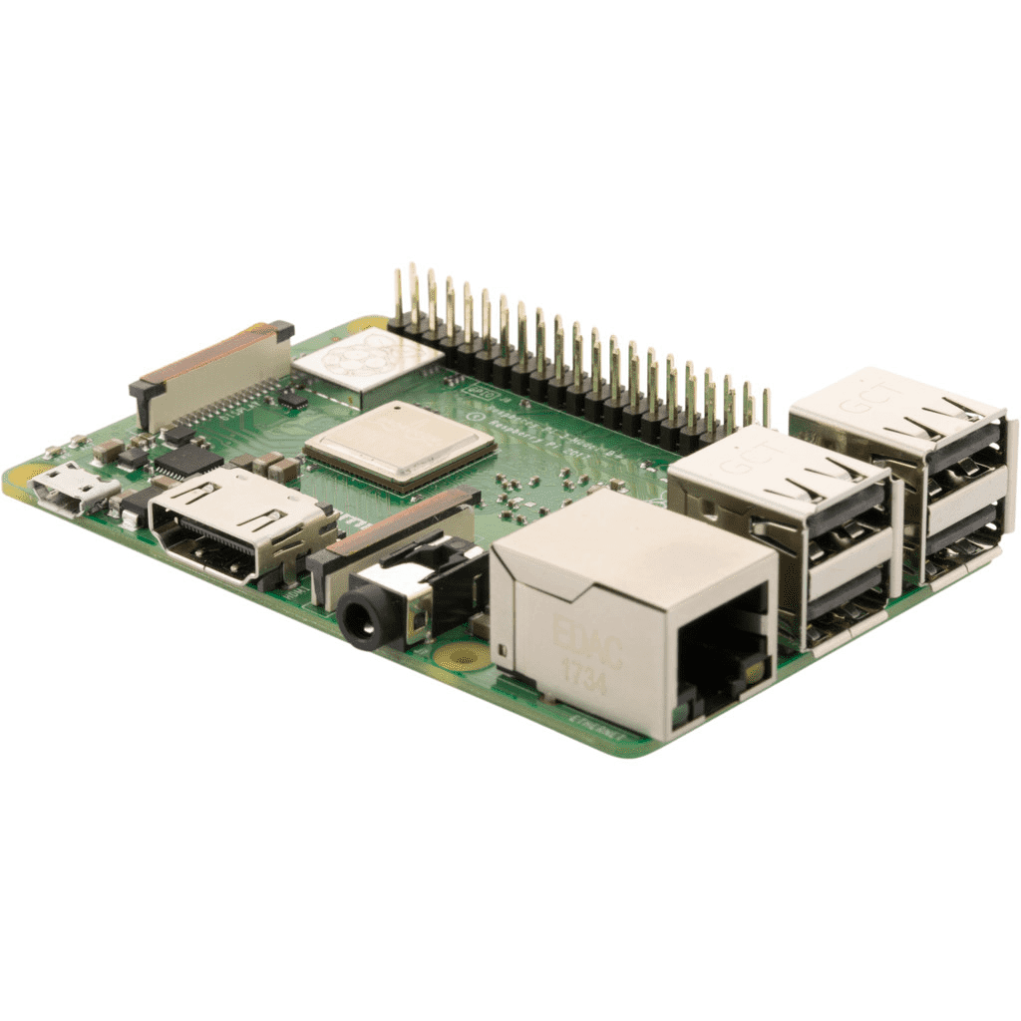

What are we working on? More Known Good Configs
19

Slide 20

Announcement!
We have positions available!
Joint MIT-UC Davis postdoc to model systems over time: https://tinyurl.com/mit-ucd-pd https://arch.cs.ucdavis.edu/projects/investigating-performance
Full-time software developer position at UC Davis coming soon

